Slide 1
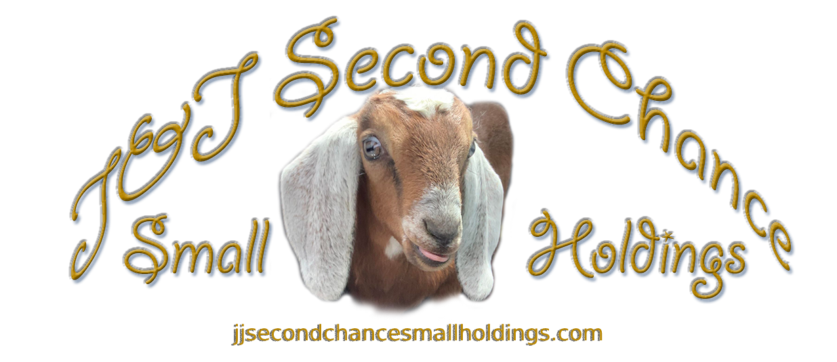
Notes:
Hello! I hope that you are having a great day.
Thank you for your interest in having goats at your event.

Slide 2
Would you like us at your Event!
Here is a quick PowerPoint to talk about setup
and more that we do for you and your event.
Notes:
Would you like us at your event?
We can do many kinds of events from private / closed to open events.
Private or Closed Events are where you have a host that can sign our release of liability and are responsible for all individuals at the event. This allows for younger individuals 6-8 and up to pet and hold goats. This is also where there is only a certain number of individuals that will be showing up (normally under 50.) At any event anyone can pet, brush, love on the goats they just have to be above a certain age to hold the goats for the safety of the goats and individuals holding them.
Private events can be at the farm as goat therapy, goat yoga and other groups under 15. Please contact us for information about larger groups. We set up in outdoor area for you to spend time with the animals.
Open Events – this is where we follow the rules of events, we can provide a copy to the Event coordinator if needed, we have fliers for those that have questions. We post the signage of the rules on the gate for the safety of the animals, us and the guests. This also helps us keep insurance cost down and this keeps the event costs down.

Slide 3
Why have Goats at Your Event?
Fun!
Something Different
Goat Therapy
Great Time
Helping Animals
Notes:
Fun – Goats are fun for all ages! Not only fun to watch but the are fun to brush love on and hold. The goats are great for helping the mood of the event to be positive and happy.
Something Different – Have you seen an event where goats are? They are a novelty and so much fun to watch on social media but they are more fun to be around.
Goat Therapy – Goats therapy is a cross of dog and horse therapy. Animals are amazing you can tell them the worst that you have done and they will still love you for being there and being you.
Great Time – You will have a great time playing with our goats. You get to take photos with the goats for you to share with your friends and family.
Helping Animals – Every event that we do is helping raise awareness of the animals at the rescue. We are a mini-farm animal rescue and sanctuary. We have many kinds of animals at the rescue from mini horses, mini donkeys, mini cows, goats and so much more. Any and all proceeds go back to the animals!

Slide 4
Here at J & J, we offer four basic types of setups to ensure we can effectively attend your events, with variations that can be tailored to accommodate different needs. This flexibility enables us to adapt to various Wyoming weather conditions and participate in a wide range of events.
Notes:
We bring all that is needed for set up.
We understand that sometimes we are unsure of how the weather will effect events so we always have options with the setup for the date. Or we will work indoors or make modifications.
We stay in contact and there are times that we have to make adjustments as we go.
We will be bringing fencing panels, chairs, tables, hand sanitizer and everything for the goats.
Every setup we bring for the goats; hay, brushes, outfits as requested and more.

Slide 5
Four Types of Setup
1. ) Outdoor setup – This is a pasture setup
2.) Indoor setup – This is a like outdoor setup with 3 layers of tarps and more
3.) Diapered setup – There are 2 versions of this
Fenced and Non-fenced
4.) Convention setup – This is a cross of the first 3
Notes:
The reason to have so many kinds of setups is that that way we can do and help as many people as possible.
Our setup can allow us to go from hospitals to schools and more.
Please see the next slides for more information about each of these along with pictures.

Slide 6
Outdoor Setup
Notes:
Outdoor setup –
This is where we setup a pen for those individuals that are participating.
It takes between 30 min and 1 hr. to set up and teardown this is not included in your time.
This can be as large as needed, or up to 50’x50’. We can setup in a clean parking lot or in a yard.
We try and keep everything as neat as we can so we sweep and clean up as we go and before we leave.
If it is a closed event then the individual can take responsibility for the group and sign a release of liability wavier for the entire group. This allows us to have youth as young as 6-8 Depending on the approved age to hold the goats with assistance. If this is an open event then the normal age of 12 with a responsible adult over the age of 18 can hold goats and 16 without parent or guardian.

Slide 7
Indoor Setup
Notes:
Indoor setup –
This is where we setup an indoor stable; this has all of the above equipment along with three layers of plastic down on the floor prior to setting up the fencing and such.
A quick explanation of setup; the first layer is 3mm plastic, then a canvas tarp to protect your floors, last is the silver tarp that is then wrapped around the fencing that is set on top of these three (3) layers. We then put down shaving and hay for the goats. We also have an extending tarp that is for when you step out to use the boot brushes so that your shoes are clean prior to leaving the area.
This is a very clean setup. We also continuously remind individuals to brush their feet, use hand sanitizer and sweep the surrounding area.
When we are done we wrap the whole thing into a bundle and take all the mess with us.
This takes approx. 1 hr. to 1.5 hours to set up and teardown this is not included in your time.

Slide 8
Diapered Setup
Notes:
There are two kinds of setups for a diapered setup
They are a maximum of a 2 hour event
Type one (1) -This is where the goats come to you wearing diapers and clothes so, no mess.
They can ride in buggies or be carried from area to area. This is one we use for offices, hospitals and such.
This takes approx. 20-30 min to set up and teardown this is not included in your time.
Type two (2) – This is where we set up a fencing, chairs, tables but the goats are wearing diapers and clothes so no mess.
This is used for indoor library reading events and birthday parties.
As we have to carry and set up more it takes 1 – 1.5 hours to set up and teardown this is not included in your time.

Slide 9
Convention Setup
Notes:
We do have a convention setup – This is a cross of all three.
There are many ways for us to be at a convention.
Type 1 - We can set up in a separate room that allows us to keep everything in one space and individuals can come and go as the convention progresses.
Type 2 – We can set up and go in and out as the convention progresses with the goats in diapers and clothes.
Type 3 – We set up outside for the event and it allows everyone to come out and visit with the goats without being inside of the building, just realize that this option is dependent on Wyoming weather.

Slide 10
Questions?
What are the costs?
Do you have insurance?
How do I know what kind of setup I need?
What if there is an emergency and we have to cancel or move the event?
How can you help?
Do you charge for setup?
Do you do Discounts?
How do I schedule an Event?
How old do you have to hold a goat?
Notes:
What are the costs? – We have a cost sheet for different events.
Do you have insurance? – Yes. We have liability insurance we can provide you with a copy if needed
How do I know what kind of setup I need? – We can discuss this and figure out what you need for your event.
What if there is an emergency and we have to cancel or move the event? – We offer rescheduling if there is an emergency, if it is a complete cancelation then we have to keep the hold fee as we held this date for you and you alone.
---------------------------------------------------------------
How can you help? – We love help, If you would like to purchase treats for the goats, or provide anything we would appreciate it. If you would like to volunteer and help us that would be awesome!
Do you charge for setup? – No that is included in your price. Our setups and teardown can take as long as 1.5 hours both ways. This is because we have to make sure that we are safe our animals are safe and so is the location and your guests. We can setup and teardown faster with help! So if you have anyone that would like to assist or volunteer that would be amazing
Do you do discounts? – Yes, these are a case by case basis, Jennifer has to give final say.
How do I schedule and event? – You contact us via jjsecondchancesmallholdings@gmail.com or via phone 307-399-7407
How old do you have to hold a goat? – it depends at a private event such as a birthday party there is a release of liability that the event coordinator signs and then we allow younger individuals to hold goats. At open event such as a library event the age is 12 and up with a responsible adult (individual over 18 that takes responsibility for the care and welfare of that minor.) if there is no adult then they have to be over 16y/o per my insurance.

Slide 11
Thank you!
For any questions please contact us at:
www.jjsecondchancesmallholdings.com
jjsecondchancesmallholdings@gmail.com
Or call 307-399-7407
Notes:
Thank you

